Slide 1
Contracts and Error Handling Strategies
CS2340
Fall 2012

Slide 2
Contracts
“The ways in which a given client can interact with a given server are described by a contract. A contract is the list of requests that a client can make of a server. Both must fulfill the contract: the client by making only those requests the contract specifies, and the server by responding appropriately to those requests. …For each such request, a set of signatures serves as the formal specification of the contract.”
—Wirfs-Brock, Wilkerson & Wiener

Slide 3
Reliability
Probablility that something satisfies its behavior requirements over time and under given conditions.
Correctness
  Does what it is supposed to do
  ... and only that
Robustness
  Acts acceptably when it can’t do what it is supposed to do
© Eiffel Software 2003, Hal Webre

Slide 4
Reliability is NOT Safety
Safety – an absence of accidents (an unplanned and unacceptable loss)
Reliable but unsafe → Mars Polar lander (misinterpretation of noise on landing leg deployment)
Safe but unreliable → Human operators (procedure deviation)

Slide 5
How?
How do engineers express what software does?
  Poorly
  Write it in natural language (English)
  Use formal system of discrete math
  All of the above

Slide 6
Detailed Contracts
“Defining a precondition and a postcondition for a routine is a way to define a contract that binds the routine and its callers….”
—Bertrand Meyer, Object-Oriented Software Construction
Meyer’s contracts add even more details. They specify:
  Obligations required of the client
  Conditions that must be true before the service will be requested
  Obligations required of the service provider
  Conditions that must be true during and after the execution of the service
  Guarantees of service
  Defined for each method or service call

Slide 7
Pre and post condition for:
Sort (of a collection)
Push (on a Stack)

Slide 8
Contract (method)
put | Obligation | Benefits
Client | (Satisfy precondition) Only call put(x) on a non-full stack | Get stack updated: x on top, not empty, remaining elements unchanged
Supplier (Server) | (Satisfy postcondition) Update stack representation to have x on top, not empty, size incr by 1 | Simpler processing thanks to assumption that stack is not full

Slide 9
Class Invariant
What is always true about a class (from a client perspective)?
For instance TimeOfDay class that has hours, minutes and seconds. What is always true?
How about our stack? What is always true?
Notes:
TimeOfDay invariant : 0<= hours <=24 , 0 <= minutes <= 59
Stack invariant 0 <= topIndex < CAPACITY, topIndex = elementCount.

Slide 10
For M3 Requirement
Method Contract:
  Signature:
    + push( x : object) : bool where push is a public instance method of Stack class and x is any instance or subclass of Object. method returns true if successful, false if x not added to stack
  precondition: true
  postcondition: size’ = size + 1. Original contents unchanged, x is new top of stack.

Slide 11
From Analysis to Design
Refine Domain Objects with Roles and Responsibilities
Create Architecture
Add Application Objects
Add Utility Objects
Refine Collaborations
Refine Object Contracts
Design Exception Handling Mechanisms

Slide 12
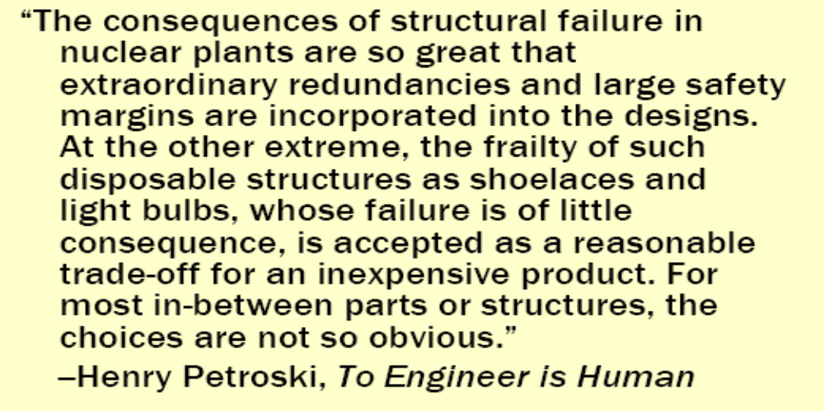
Exceptions and Reliability

Slide 13
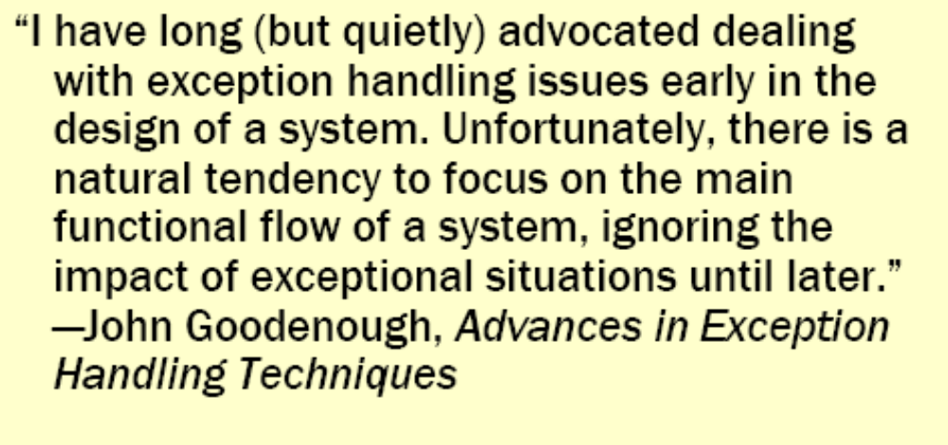
Exceptions and Design

Slide 14
A range of acceptable exposure
Loss of comfort
Loss of discretionary money
Loss of essential money
Loss of life
  Alistair Cockburn

Slide 15
What do we care about?
Error Detection
Error Containment
Error Masking
Error Correction

Slide 16
Why Not Avoid Faults Completely?
Large redundant number of highly reliable components can work against us
p = probability of failure
N = number of components
Probability System Works = (1-p)^{N}
P(one component) = (1-.05) = .95
P(100 component) = (.999)¹⁰⁰ = .90

Slide 17
Exceptions vs. Errors
Exceptions are deviations from the norm that we expect. We try to get the application in a predictable state and continue on. (Incorrect Login)
Errors are when things go unexpectedly wrong. Little can be done to recover. (Hard disk failure, Memory Error, Loss of Network Connection)

Slide 18
Types of Software Exceptions
Recoverable: The system can find an alternative work around and user can continue original task.
  FileNotFound
  Format Problems
Unrecoverable: The system continues running, but user cannot complete original task.
  IOException caused by HW fail, Out of Memory

Slide 19
Strategies
Inaction – Do nothing
Balk – Admit defeat
Guarded Suspension – Suspend execution until conditions are OK to continue
Provisional Action – Pretend to perform the action, but don’t commit until conditions are OK.

Slide 20
Strategies
Recovery – Perform an acceptable alternative
Rollback – Try to perform, but on failure undo everything
Retry – Repeatedly attempt, after recovering from failed attempts
Appeal to higher authority – Allow user to steer application
Resign – Minimize damage, write to log, signal definite and safe failure.

Slide 21
R.E.P.A.I.R.
R – Runtime : (do nothing/let it die)
E – Exception (catch and handle an exception at throw point)
P – Propogation (allow exceptions to move up system to point where you will handle them)
A – Atomic (transactions – ensure something either happens or it doesn’t)
I – Isolation (keep other processes from seeing changes. i.e. until transaction commits, nothing has happened)
R – Resumption (retry, code tries to “heal” itself)

Slide 22
Design for Exceptions
Focus on making design resilient. ID key collaborations
Develop consistent collaboration styles. Develop an application-wide policy
Consider exceptions early!
  Develop trust regions in your design
  Develop control centers, reporting and recovery strategies
Simplify your programming. Reduce exception handling clutter.

Slide 23
Exception Handling Design
There are many different ways to “handle” an exception. It could be logged and re-thrown (possibly more than once), until some object takes corrective action.
  Who naturally might handle exceptions?
    External interfacers often take responsibility for handling faulty conditions in other systems
    The initial requestor
    As a fallback, pass the buck to some object who takes responsibility for controlling the action
Handle as close to problem as possible

Slide 24
Design Guidelines
Use exceptions to represent emergencies or errors between modules
Handle exceptions as close to the problem as possible
Separate concerns (normal vs. exception)
DRY principle
Get enough information so handlers can make informed decisions
Consistency

Slide 25
Design Guidelines
Avoid creating many different exception classes. Create only if handling expected to change dramatically. Keep hierarchy flat.
Pass enough information with exception so that handlers can try to recover.
Handle exceptions don’t let them fly everywhere
Raise when the object cannot fulfill contract
Never swallow exceptions

Slide 26
More Complications
Consider the user “steering” our application. They try to make an order, but it is partially out of stock.
  split order
  wait till all in-stock
  cancel order
  modify order
This might potentially put system in unexpected state.
Sometimes we don’t want user steering system.

Slide 27
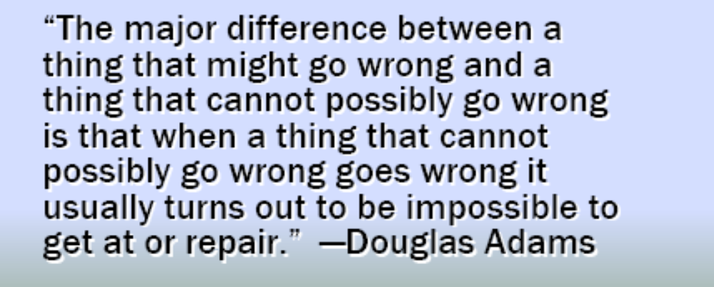
Recovery

Slide 28
Exceptions to try and anticipate
Users entering bad information or not responding at all.
Invalid information
Unauthorized or untimely requests
Dropped communications
Equipment failure
Corrupt data, bad files
Failure to complete in timely manner
Critical performance errors

Slide 29
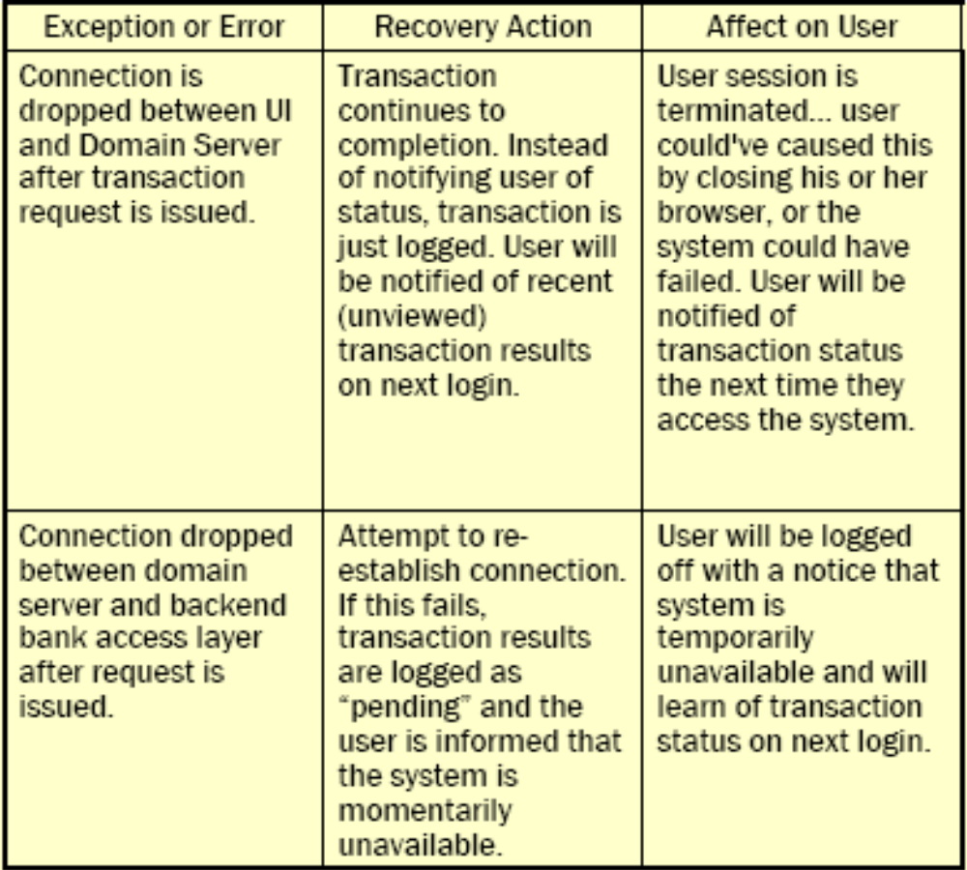
Analyzing Exceptions

Slide 30
Exception Strategy Example
Login
boolean login(String password)
ErrorType login(String password)
void login(String password) throws BadLoginException

Slide 31
M3 Exception Strategy
Write a paragraph or two describing the major exception conditions you plan for and how will you handle them. Try to have a standard consistent technique that everyone will follow.

Slide 32
Threat Modeling
[Security Design] (STRIDE)
Spoofing
  Forging an identity of a service or user
Tampering
  Compromising integrity of data
Repudiation
  Can’t prove an action committed by an entity
Information Disclosure
  Unintended disclosure of information
Denial of Service
  Compromising availability of a service
Elevation of Privileges
  An identity can gain unauthorized privileges

